Slide 1
Introduction to Fuzzy Logic
CSE451:Neural Network & Fuzzy Logic
MD Tamim Hossain
Lecturer
Department of Computer Science and Engineering
Premier University
“A positive attitude is something everyone can work on, and everyone can learn how to employ it.”
-Joan Lunden

Slide 2
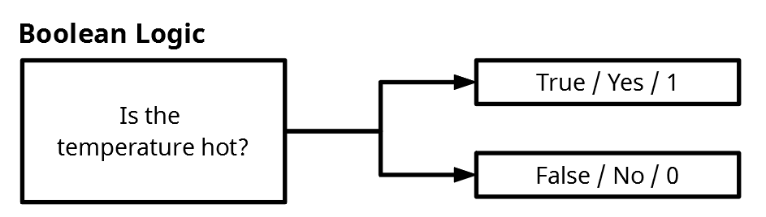
Boolean Logic/ Traditional
Boolean Logic operates based on binary values: 0 (false) and 1 (true)

Slide 3



Traditional (crisp) logic
RED
Not RED

Slide 4
Traditional (crisp) logic
What about this rose?

Slide 5
A tall guy
Where do tall people start?

Slide 6
Fuzzy Logic
Unlike two-valued Boolean logic, fuzzy logic is multi-valued. It deals with degrees of membership and degrees of truth.
Fuzzy logic is a superset of conventional (Boolean) logic that has been extended to handle the concept of partial truth -- truth values between "completely true" and "completely false".
Represent Uncertainity
Many degree of membership is possible

Slide 7
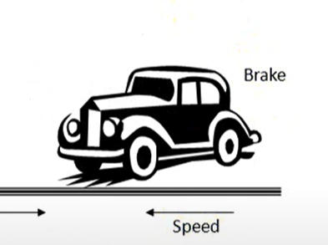
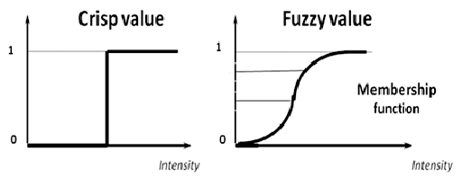
Crisp Logic
Fast
Slow
40

Slide 8
Fuzzy Set
Fast
Slow
40

Slide 9
Difference between Fuzzy and Crisp Set
Crisp Set | Fuzzy Set
Crisp set defines the value is either 0 or 1 | Fuzzy set defines the value between 0 and 1 including both 0 and 1.
It is also called a classical set. | It specifies the degree to which something is true.
It shows full membership | It shows partial membership.
Eg1. She is 18 years old. Eg2. Rahul is 1.6m tall | Eg1. She is about 18 years old. Eg2. Rahul is about 1.6m tall.

Slide 10

Crisp vs. Fuzzy Sets
Categorization of elements $x_{i}$ into a set S
Described through a membership function m(s)

Slide 11

Membership function
Classical sets contain objects that satisfy precise properties of membership;
For crisp sets (Himpunan klasik) an element x in the universe X is either a member of some crisp set A or not

Slide 12
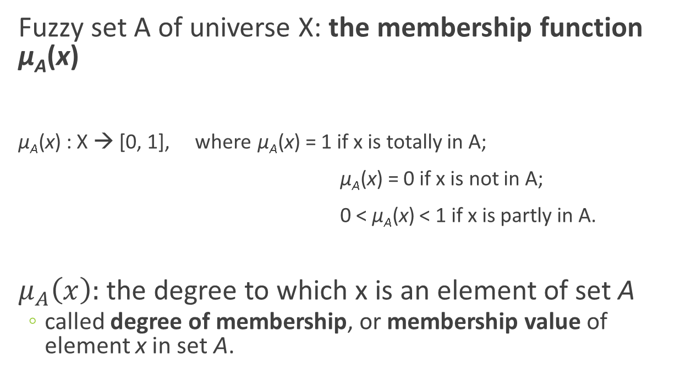
Fuzzy Sets
Fuzzy set A of universe X: the membership function µ_{A}(x)
µ_{A}(x) : X → [0, 1], where µ_{A}(x) = 1 if x is totally in A;
µ_{A}(x) = 0 if x is not in A;
0 < µ_{A}(x) < 1 if x is partly in A.
$μ_{A}\left(x\right):$the degree to which x is an element of set A
  called degree of membership, or membership value of element x in set A.

Slide 13

Membership function
Fuzzy sets contain objects that satisfy imprecise properties of membership, i.e., membership of an object in a fuzzy set can be approximate.
Membership value
Membership value
1
1
0
0
175
Height(cm)
175
Height(cm)

Slide 14
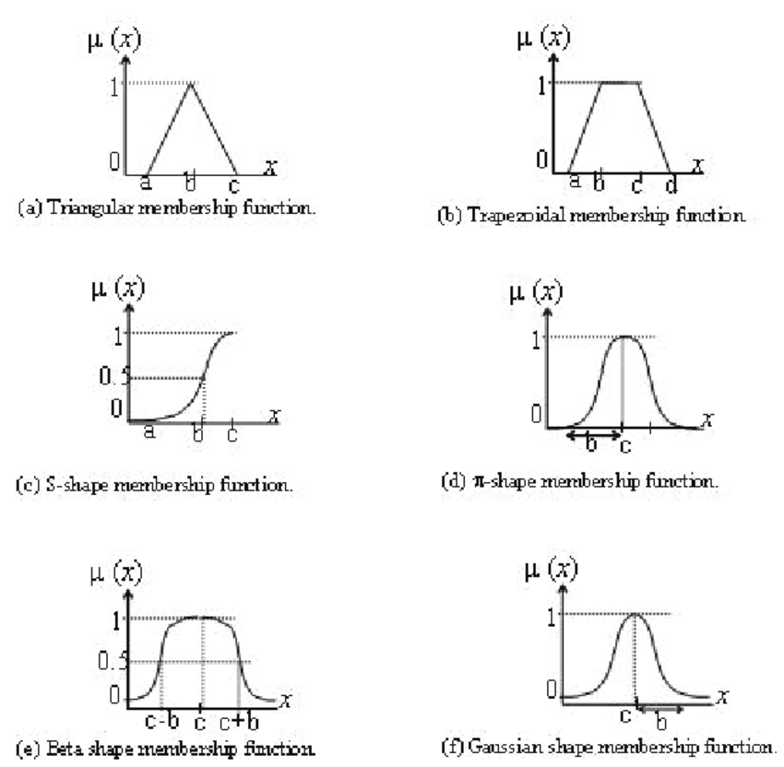
Various type of Membership Function

Slide 15
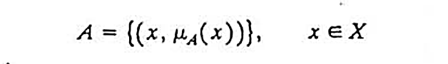
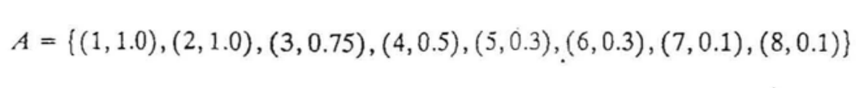
Fuzzy Representation
There are 2 commonly used ways of denoting fuzzy sets
A fuzzy set A defined on X may be written as a collection of ordered pairs

Slide 16
Fuzzy Set Representation

Slide 17
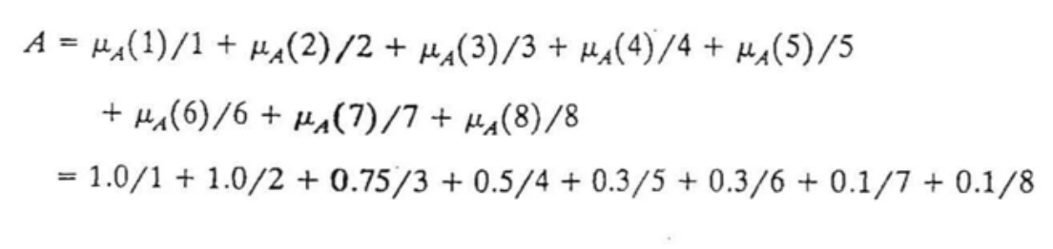
Fuzzy Representation
In this alternative notation the set of small integers maybe written as

Slide 18
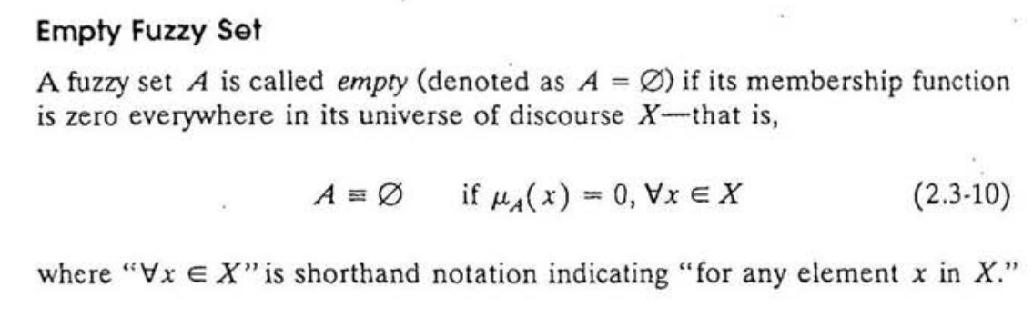
Empty Fuzzy Set

Slide 19
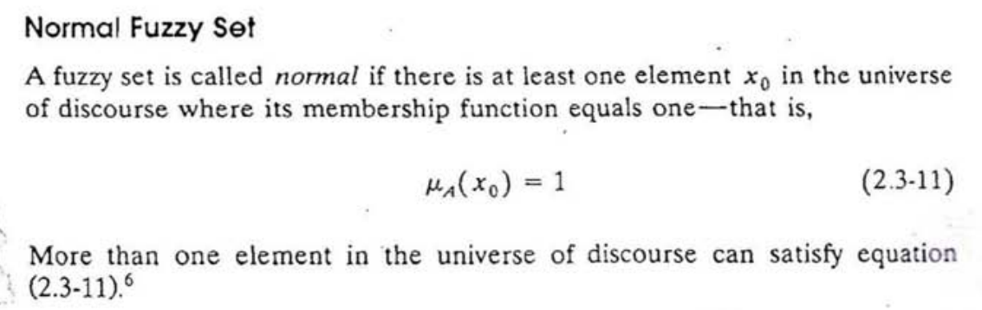
Normal Fuzzy Set

Slide 20
Fuzzy operations
Union
Intersection
Complement
Difference

Slide 21
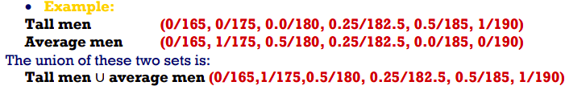
Union
Crisp Sets: Which element belongs to either set?
Fuzzy Sets: How much of the element is in either set
The union is the largest membership value of the element in either set

Slide 22
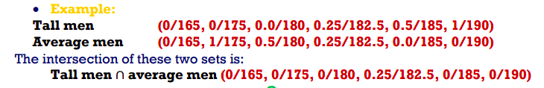
Intersection
Crisp Sets: Which element belongs to both sets?
Fuzzy Sets: To what degree the element is in both sets
The intersection is the smallest membership value of the element in either set

Slide 23

Complement
The complement of a set is an opposite of this set.

Slide 24
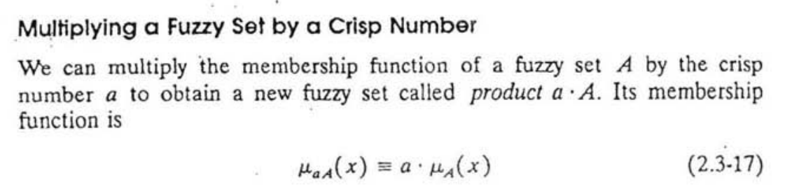
Multiplying a Fuzzy Set by a Crisp Number
We can multiply the membership function of a fuzzy set A by the crisp number a to obtain a new fuzzy set

Slide 25
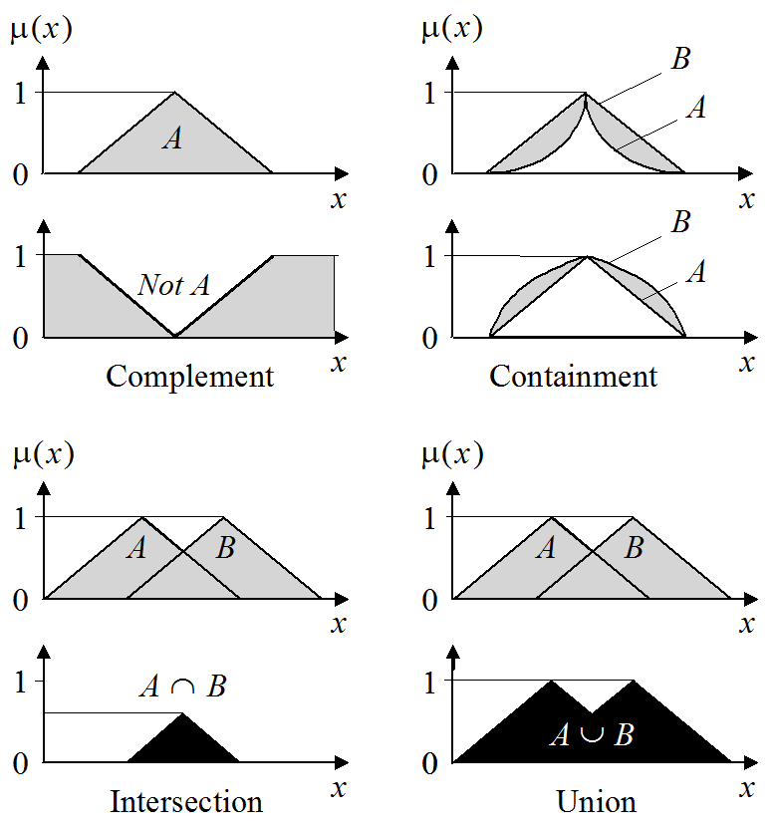
Operations of Fuzzy Sets

Slide 26
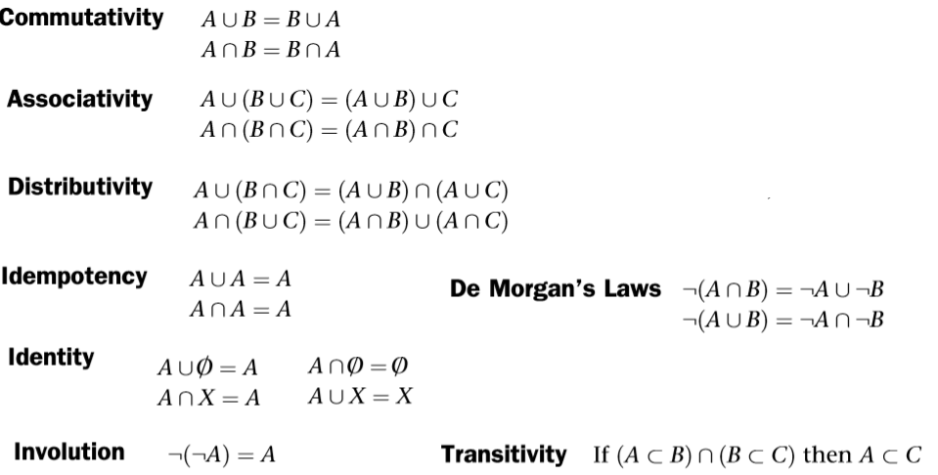
Properties of Fuzzy Sets

Slide 27
Alpha-cut
A list of all elements of fuzzy set A with membership grades greater than or equal to alpha is called the alpha-cut of A.
An α-cut or α-level set of a fuzzy set A is:
A_{α}={x|μ_{A}(x)≥α, ∀x∈X}.
Consider X = {1, 2, 3} and set A
A = 0.3/1 + 0.5/2 + 1/3
then A_{0.5} = {2,3}
A_{0.1} = {1,2,3}
A₁ = {3}

Slide 28
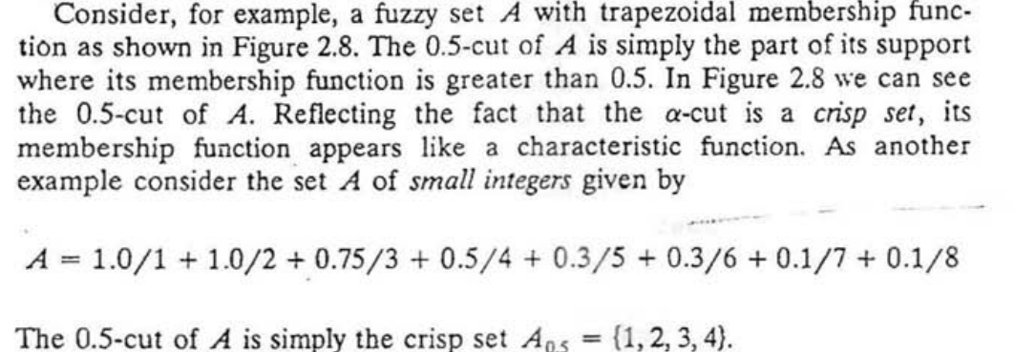
Alpha Cut

Slide 29
Alpha Cut
µA(x) = x^2 / x+ 2
What will be the α(alpha) cut corresponding to α = 0.3?

Slide 30
Fuzzy operations example
Let, fuzzy sets A and B defined on the interval X= [0, 5] of real numbers by the membership function
µa(x)= x/(x+1), µb(x)=4-(x+1).
Determine the mathematical formulas and graphs of the membership functions in each of the following sets,
i. Ac, Bc ii. A ∪ B iii. A ∩ B iv. (A ∪ B )c

Slide 31
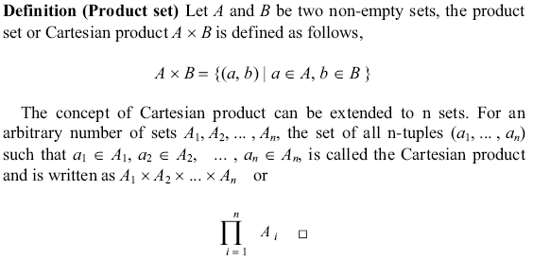
Product set

Slide 32
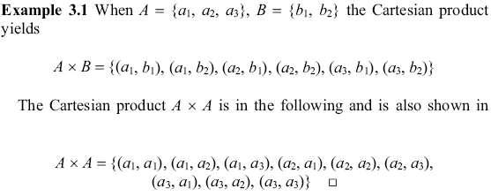
Product set

Slide 33
Product set
A={a1,a2} B={b1,b2} C={c1,c2}
AxBxC = {(a1,b1,c1),(a1,b1,c2),(a1,b2,c1),(a1,b2,c2),(a2,b1,c1),(a2,b1,c2),(a2,b2,c1), (a2,b2,c2)}

Slide 34
Crisp relation
A relation among crisp sets is a subset of the Cartesian product. It is denoted by .
Using the membership function defines the crisp relation R :

Slide 35
Fuzzy relation
A fuzzy relation is a fuzzy set defined on the Cartesian product of crisp sets A₁, A₂, ..., A_{n} where tuples (x₁, x₂, ..., x_{n}) may have varying degrees of membership within the relation.
The membership grade indicates the strength of the relation present between the elements of the tuple.

Slide 36
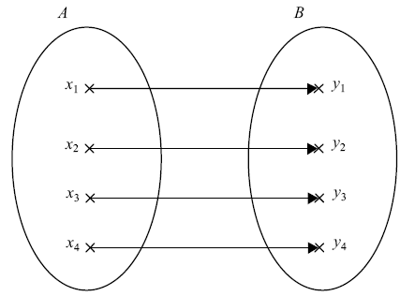
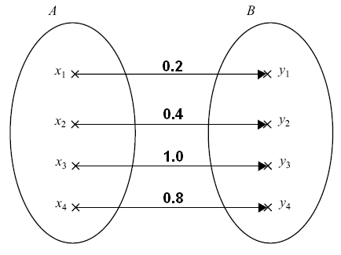
Representation methods
Bipartigraph
(Crisp)
(Fuzzy)

Slide 37
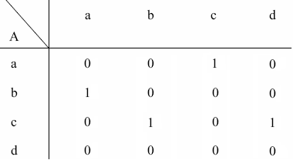
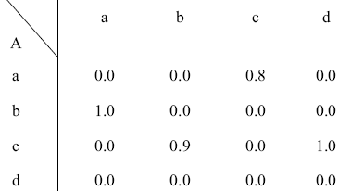
Representation methods
Matrix
(Crisp)
(Fuzzy)

Slide 38
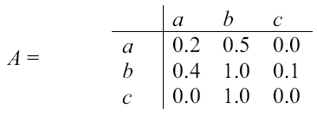
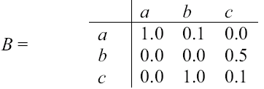
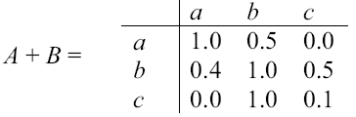
Operations on fuzzy matrices
Sum:
Example

Slide 39

Operations on fuzzy matrices
Max product: C = A・B=AB=
Example

Slide 40

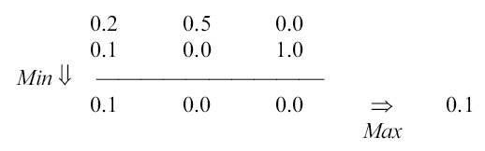
Max product
Example

Slide 41
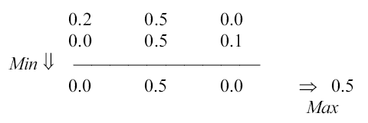
Max product
Example

Slide 42
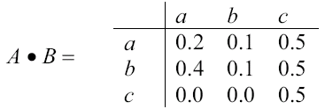
Max product
Example

Slide 43
Operations on fuzzy matrices
Scalar product:
Example

Slide 44
Operations on fuzzy relations
Union relation
For n relations

Slide 45
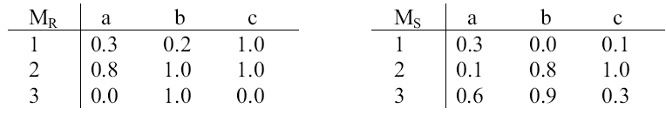
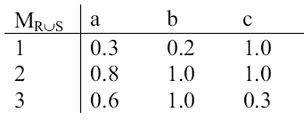
Union relation
Example

Slide 46
Operations on fuzzy relations
Intersection relation
For n relations

Slide 47
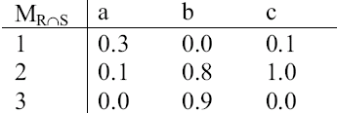
Intersection relation
Example

Slide 48
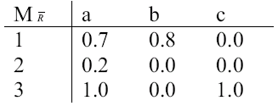
Operations on fuzzy relations
Complement relation:
Example

Slide 49
Composition of fuzzy relations
Max-min composition
Example

Slide 50
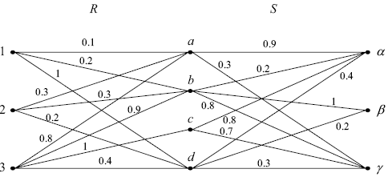
Composition of fuzzy relations

Slide 51
Composition of fuzzy relations
Example

Slide 52
Composition of fuzzy relations
Example

Slide 53
Composition of fuzzy relations

Slide 54
α-cut of fuzzy relation
Example

Slide 55
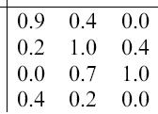
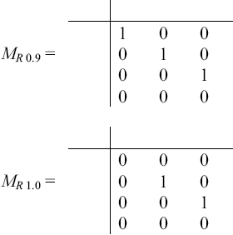
α-cut of fuzzy relation

Slide 56
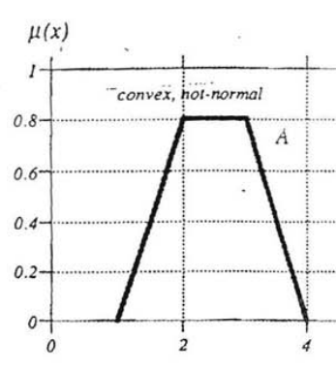
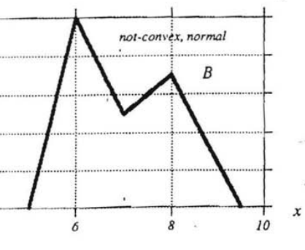

Slide 57
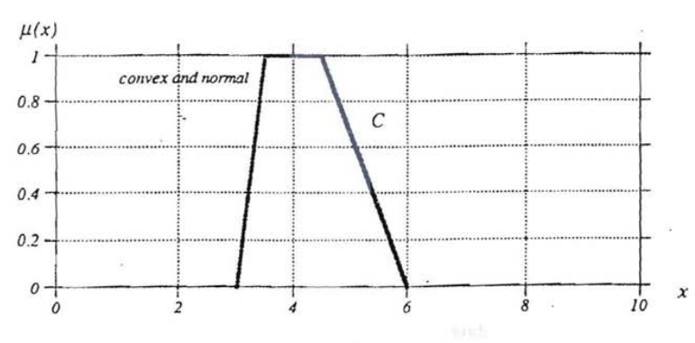

Slide 58
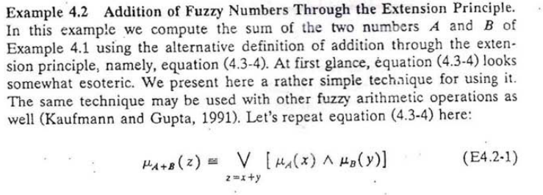

Slide 59
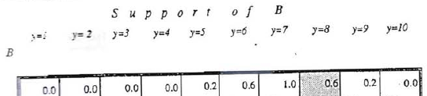

Slide 60
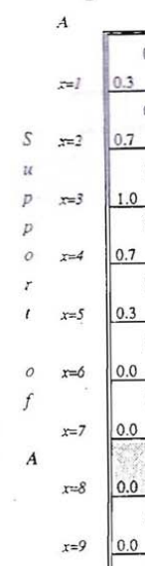

Slide 61
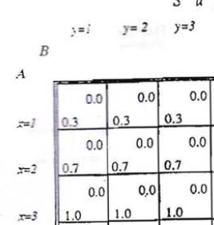
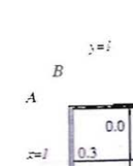
Combining two we can make

Slide 62
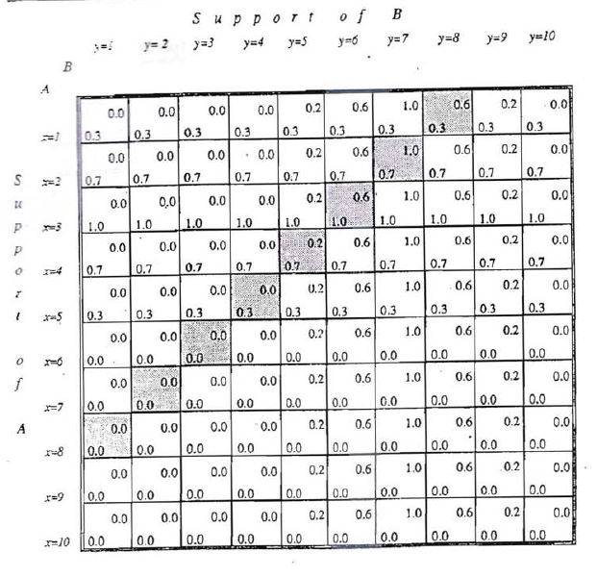

Slide 63

Suppose, we have z= 9.
There are multiple ways to get z= 9;
adding y=8, and x=1 ,
adding y=7, and x=2 ,
adding y=6, and x=3 ,
adding y=7, and x=2 ,
adding y=8, and x=1

Slide 65
